Slide 1
Chapter 5: CPU Scheduling

Slide 2
Chapter 5: CPU Scheduling
Basic Concepts
Scheduling Criteria
Scheduling Algorithms
Thread Scheduling
Multi-Processor Scheduling
Real-Time Scheduling
Operating Systems Examples
Algorithm Evaluation

Slide 3
Objectives
Describe various CPU scheduling algorithms
Evaluate CPU scheduling algorithms based on scheduling criteria
Explain the issues related to multiprocessor and multicore scheduling
Describe real-time scheduling algorithms
Apply modeling and simulations to evaluate CPU scheduling algorithms

Slide 4
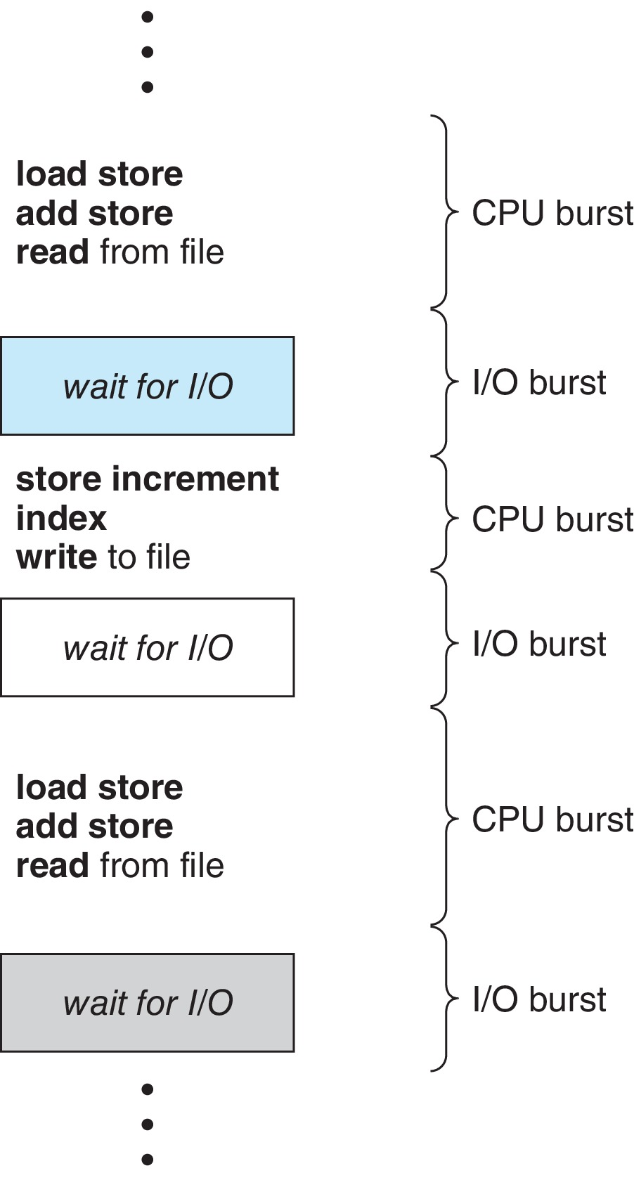
Basic Concepts
The objective of multiprogramming is to have a process running at all times - maximize CPU utilization
Process execution consists of a cycle of CPU execution and I/O wait – referred as CPU burst and I/O burst （when not running on CPU)
Whenever CPU is idle, the OS tries to select one of processes on the ready queue to execute unless the ready queue is empty
The selection of process is carried out by the CPU scheduler or called process scheduler, short-term scheduler

Slide 5
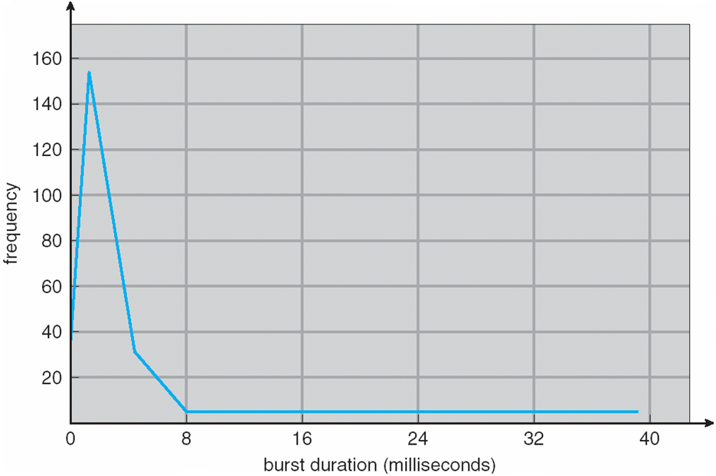
Histogram of CPU-burst Times
The durations of CPU bursts have been measured extensively over the years. The frequency curve is similar to that shown below
There are a large number of short CPU bursts and a small number of long CPU bursts (long-tail distribution). An I/O-bound program typically has many short CPU bursts, while a CPU-bound program might have a few long CPU bursts.
This distribution is important for designing a CPU-scheduling algorithm

Slide 6
CPU Scheduler
The CPU scheduler selects one process or thread from the processes on ready queue, and allocates the a CPU core to the selected process
Queue may be ordered in various ways, even single or multiple queues
CPU scheduling may take place in the following four conditions:
Switches from running to waiting state, e.g., I/O request, or wait()
Process terminates
Switches from running to ready state, e.g., interrupt
Switches from waiting to ready, e.g., completion of I/O or from new to ready, a new process arrives on the ready queue with a higher priority
Scheduling under 1 and 2 is non-preemptive, in which a process gives up CPU voluntarily (by itself)
Scheduling under 3 and 4 is preemptive
Consider access to shared data (discussed in Chapter 6)
Consider preemption while in kernel mode
Consider interrupts occurring during crucial OS activities

Slide 7
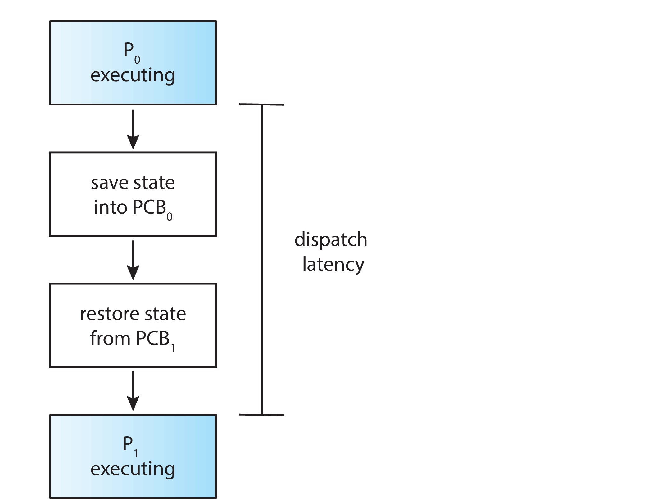
Dispatcher
Dispatcher module allocates the CPU to the process selected by the short-term scheduler; this involves:
switching context from one process to another
switching to user mode
jumping to the proper location in the user program to restart that program
Dispatch latency – the time it takes for the dispatcher to stop one process and start another running – an overhead
The number of context switches can be obtained by using vmstat on Linux, typically hundreds of context switches per second

Slide 8
Scheduling Criteria
CPU utilization – fraction of the time that CPU is busy
Throughput – # of processes or jobs completed per time unit (second)
Efficient use of the resources (CPU, memory, disk, etc.)
May be one process in seconds (long), or tens of processes/sec (short)
Waiting time – amount of time a process waiting on the ready queue
Turnaround time – the amount of time to execute a particular process, measured by the CPU burst time, I/O burst time and waiting time
Considering single CPU burst, turnaround time = waiting time + CPU burst time
Response time – the amount of time it takes from when a request was submitted until the first response is produced
Time to echo a keystroke in editor, or games
This is more relevant to interactive programs (typically using RR scheduling)
Considering single CPU burst, this is the time between the completion of first CPU time minus the time that this process joins the ready queue
Fairness
Resources such as CPU are utilized in some “fair” manner

Slide 9
Scheduling Criteria (Cont.)
It is desirable to maximize CPU utilization and throughput and to minimize turnaround time, waiting time, and response time. But these can be conflicting set of criteria, there are different considerations in practice
In most cases, we optimize an average measure, e.g., the average waiting time. However, under some circumstances, we prefer to optimize the minimum or maximum values rather than the average
Considering all users, we may want to minimize the maximum response time
For interactive systems (such as a desktop or laptop), it might be more important to minimize the variance in the response time than to minimize the average response time
A system with reasonable and predictable response time may be considered more desirable than a system that is faster on the average but is highly variable
Different CPU-scheduling algorithms have different properties. we next describe several scheduling algorithms in the context of only one CPU core – the system is capable of only running one process or thread at a time

Slide 10
First-Come, First-Served (FCFS) Scheduling
Process Burst Time
P₁ 24
P₂ 3
P₃ 3
Suppose that the processes arrive in the order: P₁ , P₂ , P₃ The Gantt Chart for the schedule is:
Waiting time for P₁ = 0; P₂ = 24; P₃ = 27
Average waiting time: (0 + 24 + 27)/3 = 17
Average turn-around time: (24+27+30)/3 = 27
In earlier systems, FCFS means that one program is scheduled to run until completion including all I/O
In multiprogramming systems, this means a process finishes its current CPU burst time

Slide 11
FCFS Scheduling (Cont.)
Suppose that the processes arrive in the order:
P₂ , P₃ , P₁
The Gantt chart for the schedule is:
Waiting time for P₁ = 6; P₂ = 0; P₃ = 3
Average waiting time: (6 + 0 + 3)/3 = 3 (much shorter!)
Average turn-around time: (30+3+6)/3 = 13
Convoy effect – A short process stuck behind a long process, bad for short jobs, potentially (depending purely on the arrival order)
Consider one CPU-bound and many I/O-bound processes, FCFS results also in low device utilization
Waiting in banks: depositing a check, stuck behind new account opening

Slide 12
Round Robin (RR)
The FCFS scheduling algorithm is non-preemptive. Once the CPU core allocated to a process, the process keeps the CPU until it releases CPU
The FCFS is thus particularly troublesome for interactive systems, where it is important that each process get a share of the CPU at regular intervals.
The round-robin (RR) scheduling algorithm is similar to FCFS scheduling, but preemption is added to enable system to switch between processes
Each process gets a small unit of CPU time (time quantum q), usually 10-100 milliseconds. After this time has elapsed, the process is preempted and added to the end of the ready queue (exactly like FCFS).
Given n processes, each process gets 1/n of the CPU time in chunks of at most q time units at once – context switching time is ignored
No process waits more than (n-1)q time units.
A timer interrupts every quantum to schedule next process, or the process blocks upon completing its current CPU burst time when its CPU burst time < q

Slide 13
Example of RR with Time Quantum = 4
Process Burst Time
P₁ 24
P₂ 3
P₃ 3
The Gantt chart is: Waiting time for P1=6, P2=4,P3=7
Average waiting time (6+4+7)/3 = 5.67
Average turn-around time: (30+7+10)/3 = 15.67
Response time for P1=4, P2=7, P3=10, average = 7
The average waiting time under RR policy can be long, but is inherently more “fair” (FIFO order), usually perform better for short jobs than FCFS, and offers better average response time – important for interactive jobs

Slide 14
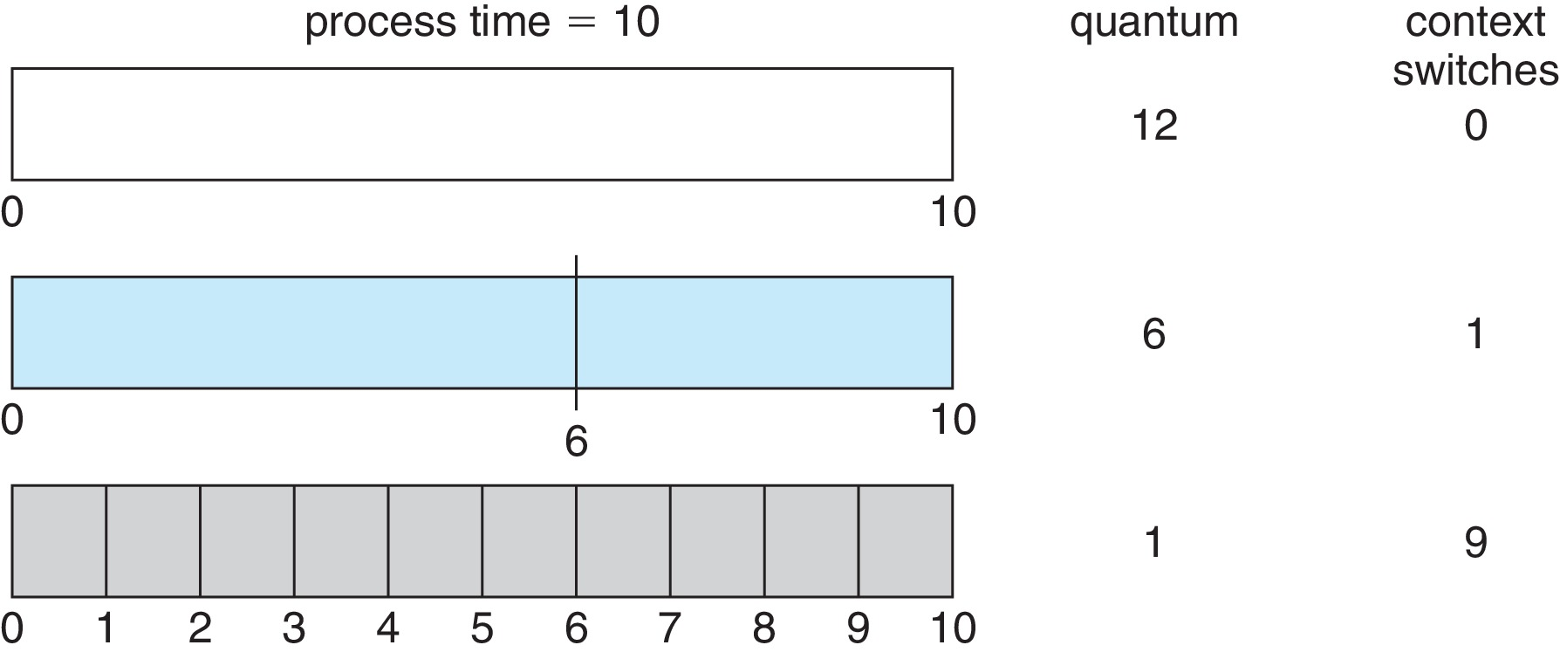
Time Quantum and Context Switch Time
The performance of the RR algorithm depends heavily on the size of the time quantum
q large ⇒ FCFS
q small ⇒ interleaved, but q must be large with respect to context switch time (usually < 10 usec), otherwise overhead is too high

Slide 15
Comparisons between FCFS and RR
Assuming zero-cost context-switching time, is RR always better than FCFS?
An example: 10 jobs starting at the same time, each taking 100s of CPU time; RR scheduler quantum of 1s;
The average job turn-around time is much worse under RR!
Bad when all jobs have the same length

Slide 16
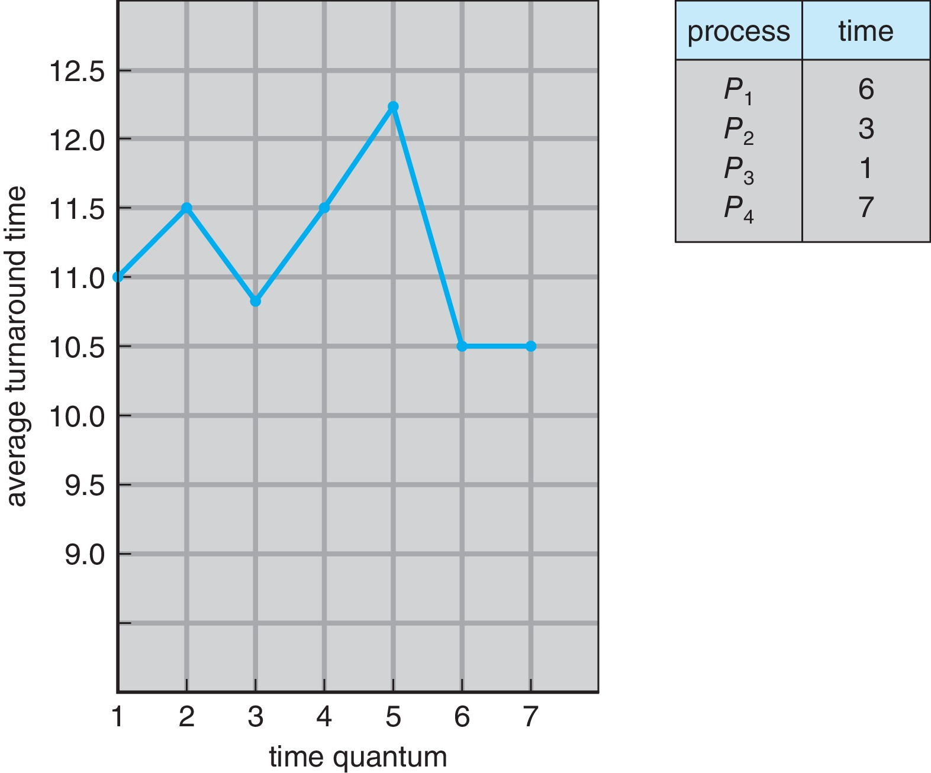
Turnaround Time Varies With The Time Quantum
The average turnaround time does not necessarily improves as the time quantum size increases
In general, the average turnaround time can be improved if most processes finish their current CPU bursts within a single quantum
The time quantum can not be too big, in which RR degenerates to an FCFS policy
A rule of thumb: 80% CPU bursts should be shorter than the time quantum q

Slide 17
Shortest-Job-First (SJF) Scheduling
Noticing that in FCFS and RR, we do not need to know the next CPU burst time of each process during scheduling, and scheduling is done based on the arrival order
What if we knew the future – the next CPU burst time of each process
Associate with each process the length of its next CPU burst
To schedule the process with the shortest next CPU burst
The Shortest Job First or SJF scheduling algorithm is optimal – produces the minimum average waiting time for a given set of processes
The difficulty is knowing the length of the next CPU request
The basic idea is to get the short jobs out of the system sooner
Big effect on short jobs, relatively small effect on long jobs
This can be applied to an entire program or the current CPU burst
Perhaps a more precise term should be the shortest-next-CPU-burst algorithm, but shortest job first or SJF is commonly used.

Slide 18
Example of SJF
ProcessArriva l Time Burst Time
P₁ 0.0 6
P₂ 2.0 8
P₃ 4.0 7
P₄ 5.0 3
SJF scheduling chart
Average waiting time = (3 + 16 + 9 + 0) / 4 = 7
The “best” FCFS perform the same if arrival order happens to be the same
Sketch Proof: Moving a short process before a long one decreases the waiting time of the short process more than it increases the waiting time of the long process. Consequently, the average waiting time decreases

Slide 19
Determining Length of Next CPU Burst
How to estimate the length based on the past behavior
Then pick the process with shortest predicted next CPU burst
Can be done by using the lengths of previous CPU bursts and exponential averaging algorithm
Commonly, α set to ½ - the relative weight of recent and past history in the prediction
Preemptive version called shortest-remaining-time-first （SRTF）
τ_{n+1}

Slide 20
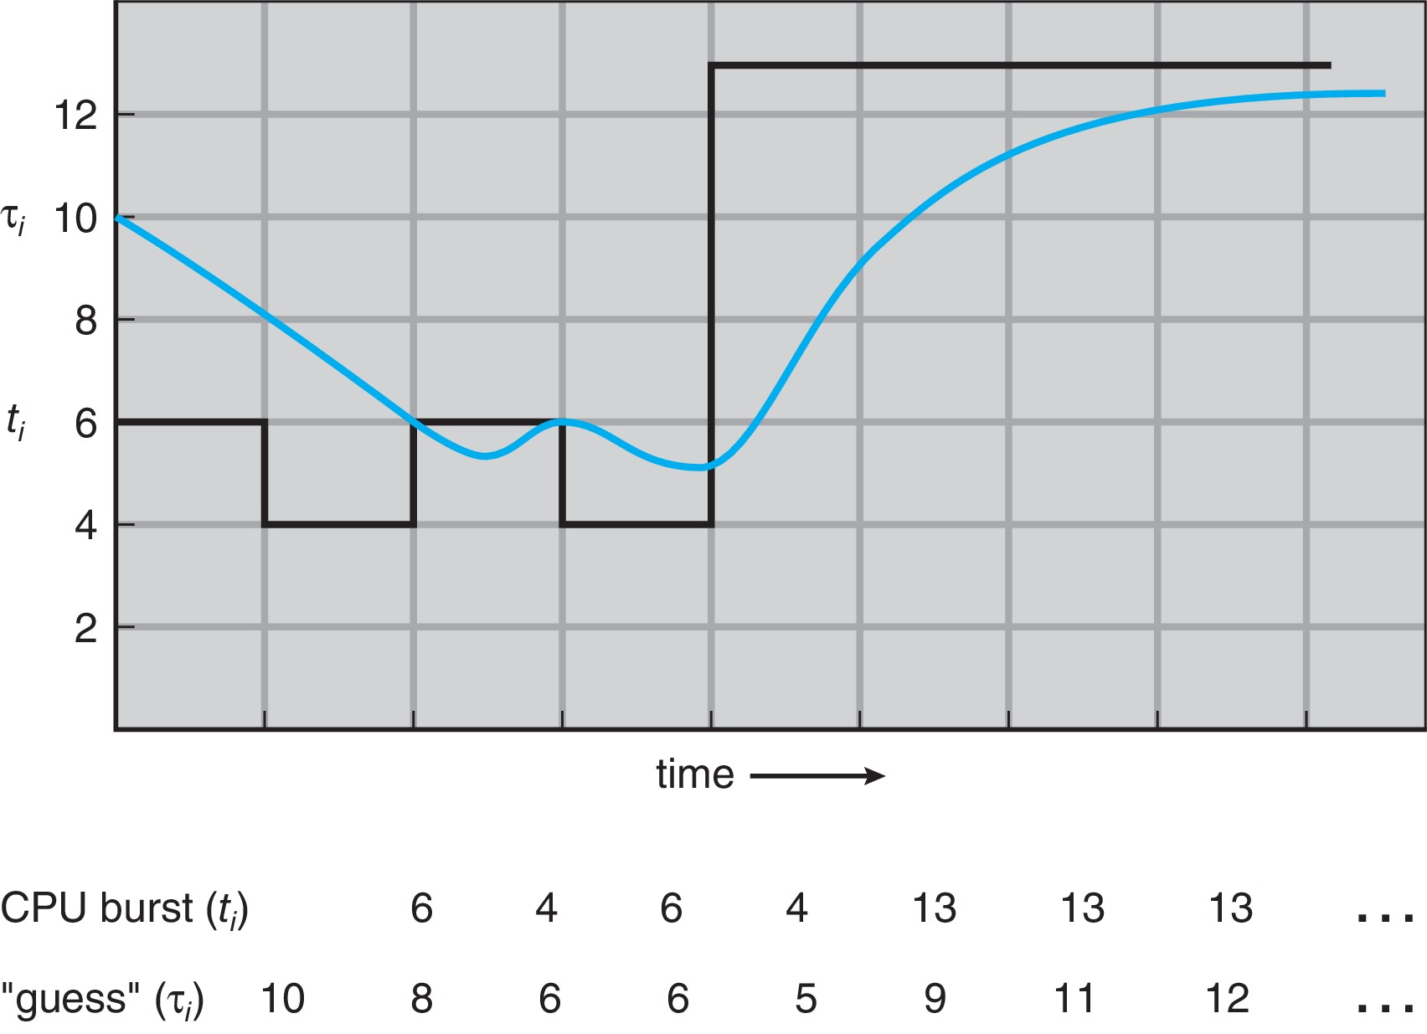
Prediction of the Length of the Next CPU Burst
This shows an exponential average with α = 1/2 and τ0 = 10.

Slide 21
Examples of Exponential Averaging
α =0
τ_{n+1} = τ_{n}
Recent history does not count
α =1
τ_{n+1} = α t_{n}
Only the actual last CPU burst counts
If we expand the formula, we get:
τ_{n+1} = α t_{n}+(1 - α)α t_{n} ₋₁ + … +(1 - α )^{j} α t_{n} _{-j} + … +(1 - α )^{n +1} τ₀
Since both α and (1 - α) are less than or equal to 1, each successive term has less weight than its predecessor， thus its effect is diminishing exponentially fast

Slide 22
Example of Shortest-Remaining-Time-First
The SJF algorithm can be either preemptive or nonpreemptive. The choice arises when a new process arrives at the ready queue while another process is still executing
ProcessA arri Arrival TimeT Burst Time
P₁ 0 8
P₂ 1 4
P₃ 2 9
P₄ 3 5
Preemptive SJF Gantt Chart
Average waiting time = [(10-1)+(1-1)+(17-2)+5-3)]/4 = 26/4 = 6.5
Now scheduling needs to be considered when there is an arrival to the ready queue (scheduling condition 4)

Slide 23
Comparison of SJF/SRTF and FCFS
SJF/SRTF are the best we can do towards minimizing the average waiting time. or the average turnaround time
Provably optimal (SJF among non-preemptive, SRTF among preemptive)
SRTF is always at least as good as SJF
SJF/SRTF performs the same as FCFS if all processes have the same CPU burst times
SJF/SRTF can possibly lead to starvation for long process if there is always shorter process joining the ready queue
“fairness” can not be enforced

Slide 24
Priority Scheduling
A priority number (e.g., integer) is associated with each process
The CPU is allocated to the process with the highest priority (smallest integer ≡ highest priority), it can be
Preemptive （upon new arrival of a higher priority process)
Nonpreemptive
Equal-priority processes are scheduled in FCFS order
SJF is is a special case of the general priority-scheduling algorithm, where priority is the inverse of predicted next CPU burst time
Problem ≡ Starvation – low priority processes may never execute
Solution ≡ Aging – as time progresses increase the priority of the process

Slide 25
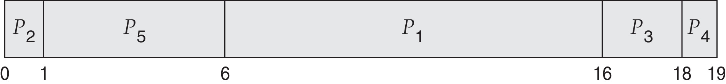
Example of Priority Scheduling
ProcessA arri Burst TimeT Priority
P₁ 10 3
P₂ 1 1
P₃ 2 4
P₄ 1 5
P₅ 5 2
Priority scheduling Gantt Chart
Average waiting time = 8.2 msec

Slide 26
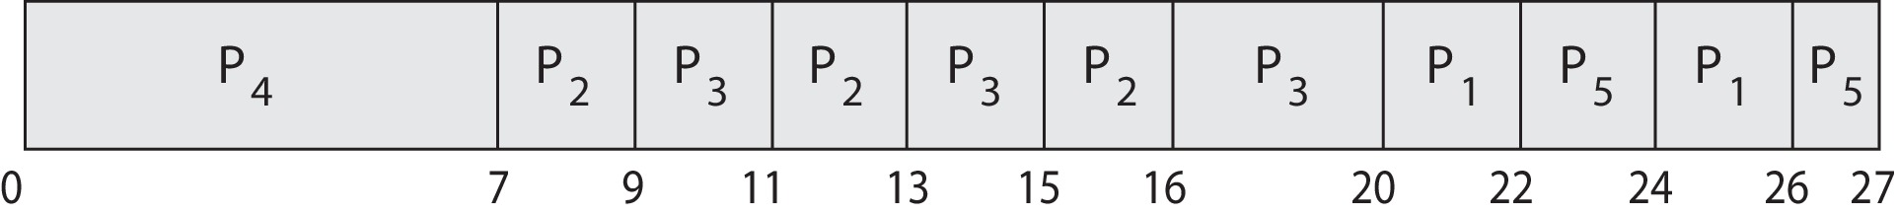
Priority Scheduling w/ Round-Robin
ProcessA arri Burst TimeT Priority
P₁ 4 3
P₂ 5 2
P₃ 8 2
P₄ 7 1
P₅ 3 3
Run the process with the highest priority. Processes with the same priority run round-robin
Gantt Chart with 2 ms time quantum

Slide 27
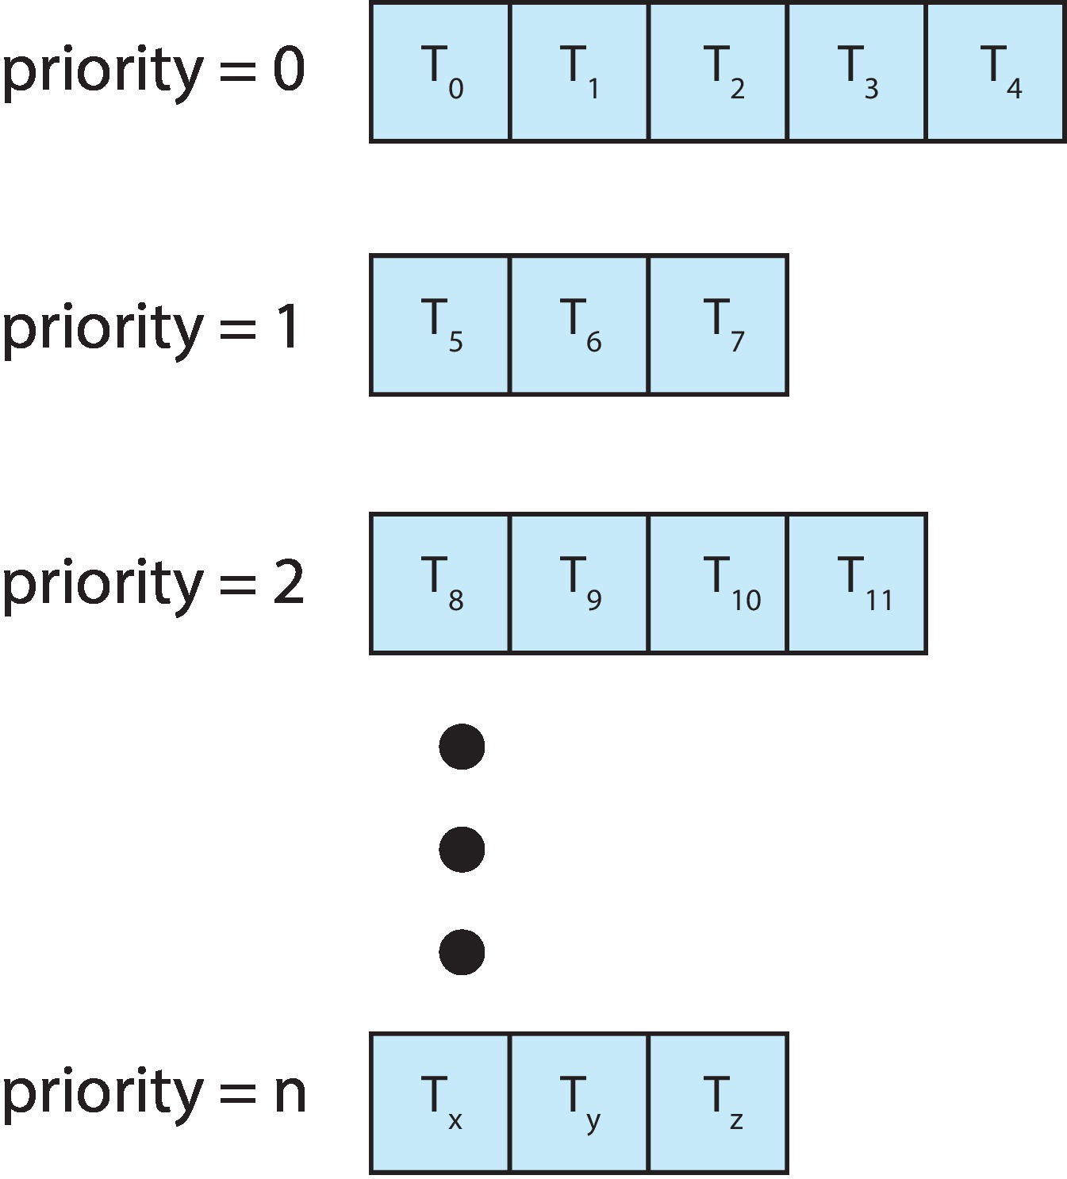
Multilevel Queue
Multilevel queue scheduling can still be a priority scheduling combined with round-robin
A priority is assigned statically to each process, and a process remains in the same queue for the duration of its runtime

Slide 28
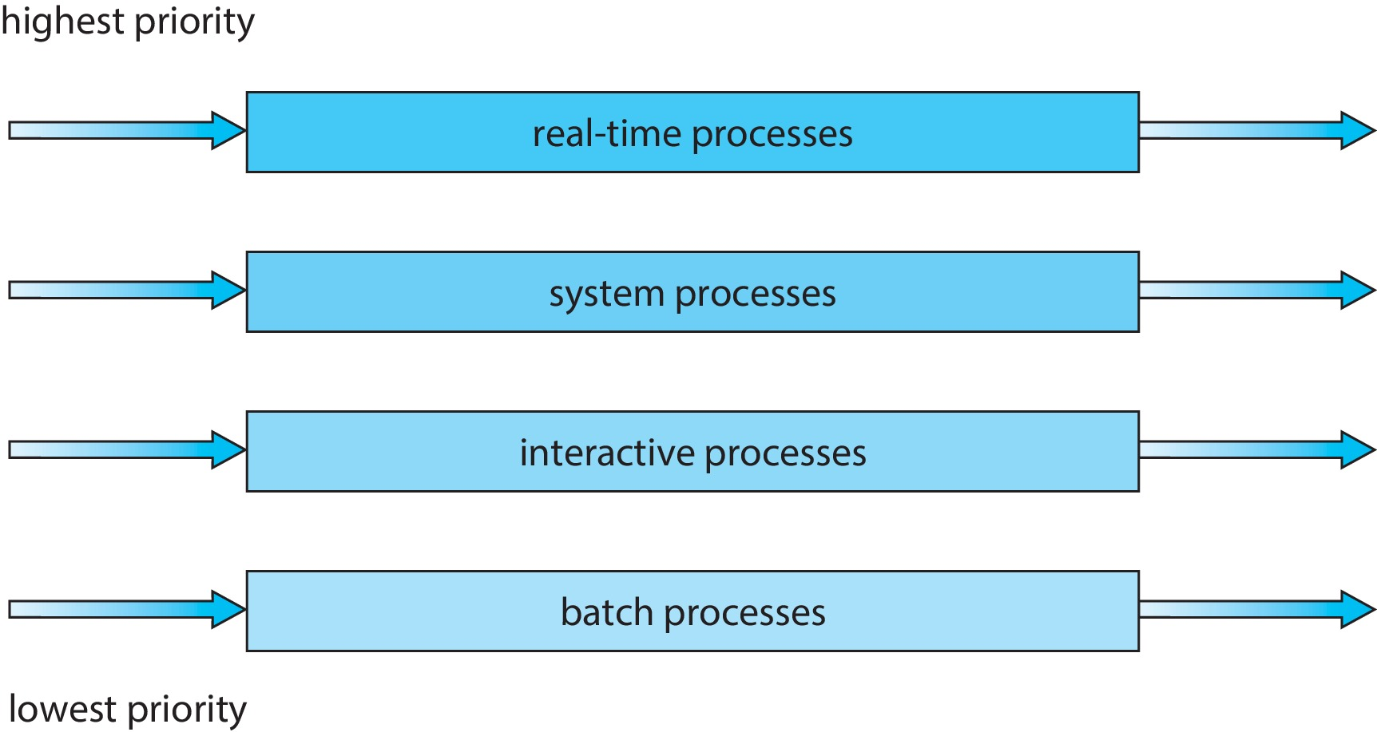
Multilevel Queue (Cont.)
Partition processes into different queues based on process type
Each queue can have its own scheduling algorithm based on the needs
The scheduling among the queues, is commonly implemented as fixed-priority preemptive scheduling or each queue gets certain amount of CPU time – time-slice (for instance 60%, 20%, 10%, 10%）

Slide 29
Multilevel Feedback Queue (MLFQ)
A process can move between the various queues; aging can be implemented this way. This provides the flexibility
Multilevel-feedback-queue or MLFQ scheduler defined by the following parameters:
The number of queues
scheduling algorithms for each queue
method used to determine when to upgrade a process
method used to determine when to demote a process
method used to determine which queue a process will enter when that process needs service

Slide 30
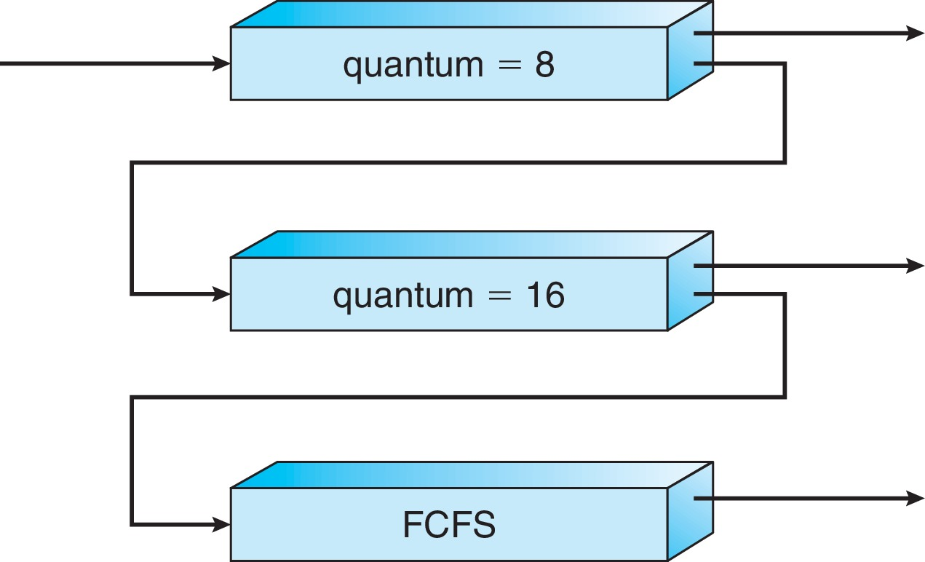
Example of Multilevel Feedback Queue
Three queues:
Q₀ – RR with time quantum 8 milliseconds
Q₁ – RR time quantum 16 milliseconds
Q₂ – FCFS
Scheduling
A new job enters queue Q₀ which is served FCFS, also preempts jobs from Q1 or Q2 if currently running on CPU
When it gains CPU, job receives 8 ms
If it does not finish in 8 milliseconds, job is moved to the queue Q₁
At Q₁ job is again served FCFS and receives 16 additional milliseconds
If it still does not complete, it is preempted and moved to queue Q₂
If a job from Q₁ or Q₂ is preempted by a new job from Q₀, it joins the head of the queue Q₁ or Q₂ , respectively
This approximates SRTF:
CPU bound jobs drop like a rock
Short-running I/O bound jobs stay near top

Slide 31
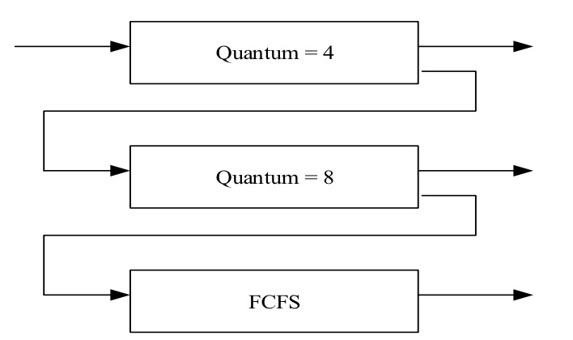
MLFQ Example
Process | Arrival Time (ms) | Burst Time (ms)
P1 | 0 | 10
P2 | 2 | 15
P3 | 5 | 2
P4 | 12 | 14
P5 | 18 | 6

Slide 32
MLFQ Scheduling: Example
Process | Burst Time | Arrival Time | Remaining Time
P1 | 10 | 0
6
10
6
8
0
2
2
4
√
4
P2
2
P2
15
15
2
3
15
15
14
3
11
11
√
0
P3
√
P3
2
2
5
5
2
2
0
14
14
12
12
10
10
0
2
P4
2
√
P4
14
P5
P5
6
18
6
18
0
2
6
√
2
P1
P2
P3
P1
P4
P1
P5
P1
P2
P4
P5
P2
P4
0
4
8
10
12
16
18
22
24
32
40
42
45
47
P2
Q0
P3
P2
P1
P3
P5
P4
at time 47: P4 finishes
at time 22: P5 gets preempted and waits in Q1; P1 gets service in Q1
at time 32: P2 gets preempted and waits in Q2; P4 gets service in Q1
at time 45: P2 finishes; P4 gets service in Q2
at time 40: P4 gets preempted and waits in Q2; P5 gets service in Q1
at time 16: P4 gets preempted and waits in Q1; P1 gets service in Q1
at time 42: P5 finishes; P2 gets service in Q2
at time 24: P1 finishes; P2 gets service in Q1
at time 18: P5 arrives and gets service in Q0; P1 gets preempted in Q1
at time 12: P4 arrives and gets service in Q0; P1 gets preempted in Q1
at time 10: P3 finishes; P1 gets service in Q1
at time 8: P2 gets preempted and waits in Q1; P3 gets service in Q0
at time 2: P2 arrives and waits in Q0
at time 4: P1 gets preempted and waits in Q1; P2 gets service in Q0
at time 0: P1 arrives and gets service in Q0
at time 5: P3 arrives and waits in Q0
P2
P1
P1
P5
P5
P1
P2
P1
P5
P1
P4
P4
P4
P1
Q1
P5
P4
P4
P2
P2
Q2

Slide 33
MLFQ Scheduling: Example
Process | Burst Time | Arrival Time | Remaining Time
P1 | 10 | 0
0
P2
15
2
0
P3
2
5
0
P4
14
12
0
P5
6
18
0
P1
P2
P3
P1
P4
P1
P5
P1
P2
P4
P5
P2
P4
0
4
8
10
12
16
18
22
24
32
40
42
45
47
2
5
Waiting time for
P1=14, P2=2+16+10=28
P1=6+4+4=14
P1=14, P2=28, P3=3
P1=14, P2=28, P3=3, P4=16+5=21
P1=14, P2=28, P3=3, P4=21, P5=18
P1=14, P2=28, P3=3, P4=21, P5=18
Average waiting time: (14+28+3+21+18)/5=16.8

Slide 34
Multilevel Feedback Queue (MLFQ)
MLFQ is commonly used in many systems such as BSD Unix, Solaris, Window NT and subsequent Window operating systems
MLFQ has several distinctive advantages:
It does not need prior knowledge on the next CPU burst time
It handles interactive jobs well by delivering similar performance as that of SJF or SRTF
It is also “fair” by making progress on CPU-bound jobs
The possible starvation problem can be handled by reshuffling the jobs to different queues periodically
E.g., after some period, move all jobs to the top queue

Slide 35
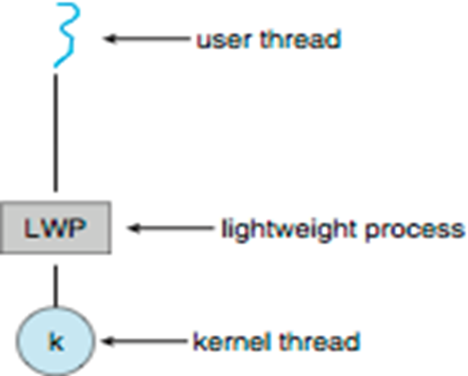
Thread Scheduling
On modern OS, kernel-level threads are the ones being scheduled, user-level threads are managed by a thread library instead
The OS can use an intermediate data structure between user threads and kernel threads, a lightweight process (LWP)
Appears as a virtual processor on which user threads are scheduled to “run”
Each LWP attached to kernel thread (one-to-one)

Slide 36
Thread Scheduling
Under many-to-one and many-to-many models, thread library “schedules” user-level threads to run on LWP. This is known as process-contention scope (PCS).
Since scheduling competition takes place among the threads belonging to the same process, typically done via priority set by programmers
Thread library usually can not adjust the priority
PCS will typically preempt the thread currently running in favour of a higher-priority (user-level) thread
Kernel thread scheduled onto available CPU is system-contention scope (SCS) – competition among all threads in the system – CPU scheduling
Systems using one-to-one mapping model, such as Windows, Linux, and Solaris, schedule threads using only SCS

Slide 37
Multiple-Processor Scheduling
CPU scheduling far more complex with multiple CPUs – load sharing
Traditionally, the term multiprocessor referred to systems that provided multiple physical processors, where each physical processor chip contained one single-core CPU
The definition of multiprocessor has evolved significantly, and in modern computing systems, multiprocessor now applies to multicore CPUs, multithreaded cores, NUMA systems, and heterogeneous multiprocessing
There are generally two types of multiprocessing systems, asymmetric multiprocessing and symmetric multiprocessing
Asymmetric multiprocessing – only one processor can access kernel data structures, alleviating the need for data sharing. The other processors execute only user codes
All scheduling decisions, I/O processing, and other system activities handled by a single processor — the master server
The master server can become a potential bottleneck

Slide 38
Symmetric multiprocessing (SMP)
Symmetric multiprocessing (SMP) – each processor is self-scheduling, with one common ready queue, or each having its own private ready queue
Scheduling proceeds by having the scheduler of each processor examine the ready queue and select a thread to run
To ensure two separate processors do not choose to schedule the same thread with a common ready queue - possible race condition (discuss in Chapter 6)
All modern OS support SMP, including Window, Linux, Mac OS X, as well as mobile systems including Android and iOS

Slide 39
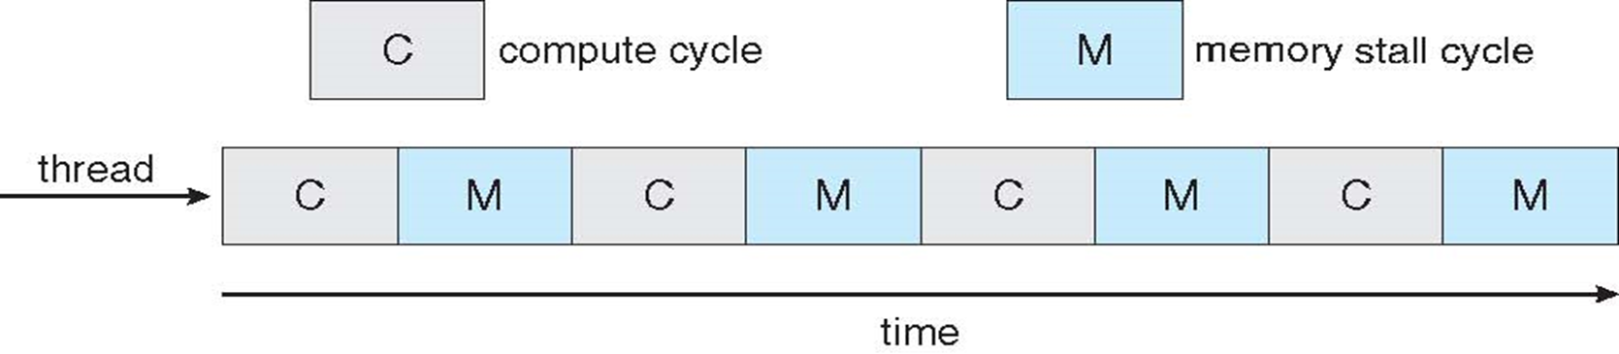
Multicore Processors
Recent trend to place multiple processor cores on same physical chip
Faster and consumes less power, but complicate the scheduling design
Memory stall: when a processor accesses memory, it spends a significant amount of time waiting for data to become available, primarily because modern processors operate at much faster speeds than memory, esp. when there is a cache miss
Multiple hardware threads per core - each hardware thread has its own state, program counter (PC), register set appearing as a logical CPU to run a software thread. This is known as chip multithreading (CMT)

Slide 40
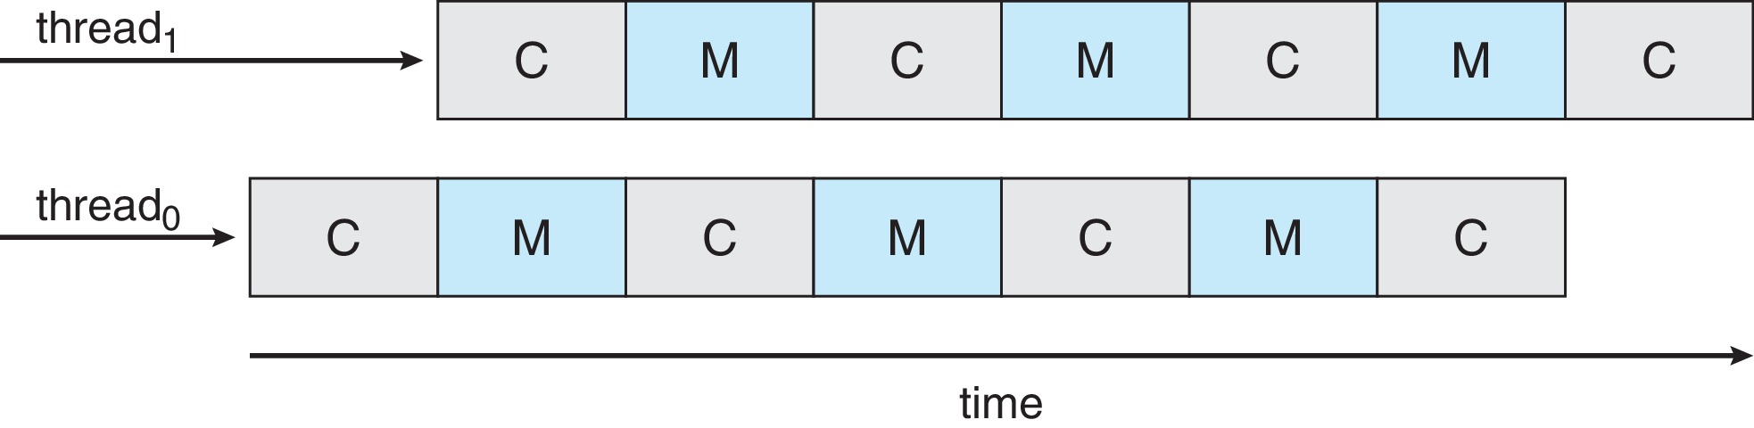
Multithreaded Multicore System
The scheduling can takes advantage of memory stall to make progress on another hardware thread while memory retrieve happens
If one thread stalls while waiting for memory, the core can switch to another thread. This becomes a dual-thread processor core, or resembles two logical processors
A dual-threaded, dual-core system presents four logical processors to the operating system
UltraSPARC T3 CPU has 16 cores per chip and 8 hardware threads per core, from operating system perspective, this appear to be 128 logical processors

Slide 41
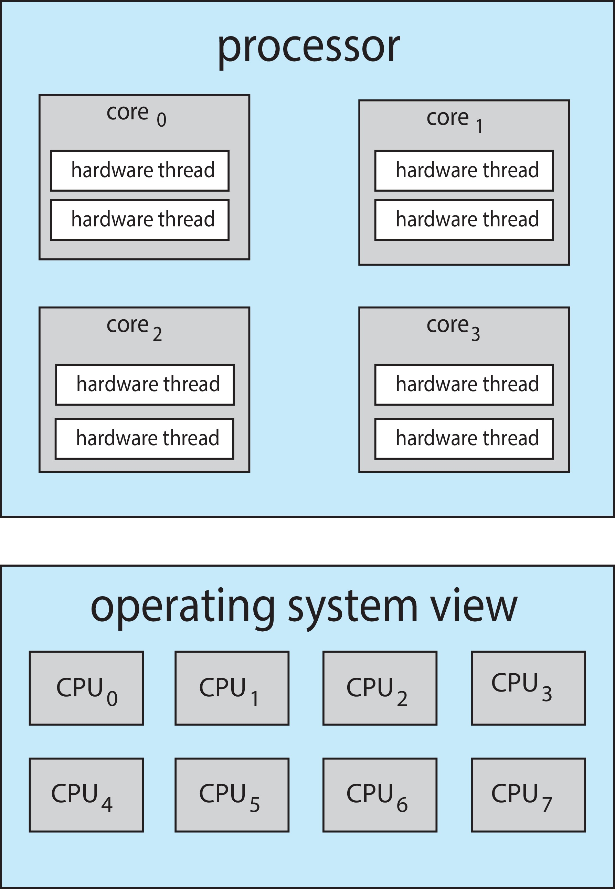
Multithreaded Multicore System
From an operating system perspective, each hardware thread maintains its architectural state, such as instruction pointer and register set, and thus appears as a logical CPU that is available to run a software thread
Chip-multithreading (CMT) assigns each core multiple hardware threads. (Intel refers to this as hyperthreading)
On a quad-core system with 2 hardware threads per core, the operating system sees 8 logical processors.

Slide 42
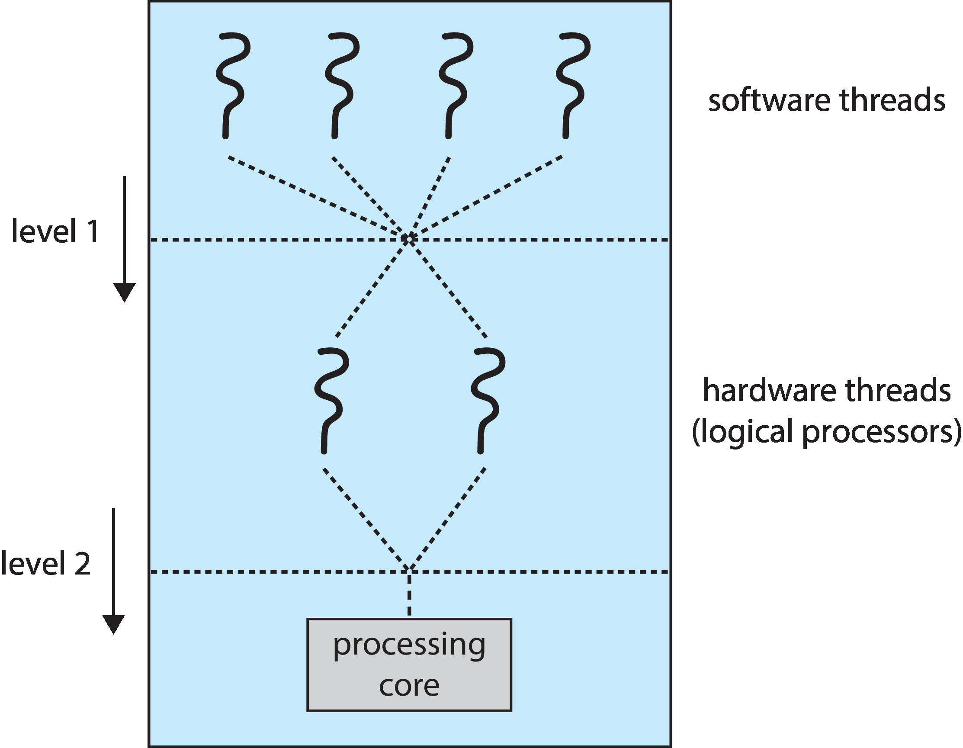
Multithreaded Multicore System
Two levels of scheduling:
The operating system deciding which software thread (kernel thread) to run on a logical CPU – CPU scheduling that we cover in this Chapter
How each core decides which hardware thread to run on the physical core – could use RR scheduling (UltraSPARC T3)

Slide 43
Multithreaded Multicore Scheduling
A user-level thread is schedule to a LWP – a kernel-level thread
Under many-to-one and many-to-many models, thread library schedules user-level threads known as process-contention scope (PCS), typically based on the priority set by programmers
A kernel thread now referred as a software thread is scheduled onto a logical CPU – a hardware thread
CPU or process scheduling – operating system
A hardware thread is scheduled to run on a CPU core
Each CPU core decides the scheduling, typically using RR

Slide 44
Processor Affinity
Processor affinity – process has an affinity for a processor on which it runs
When a thread has been running on one processor, the cache content of that processor stores the memory accesses by that thread. We refer to this as a thread having affinity for a processor (i.e. “processor affinity”)
There is a high cost of invalidating and repopulating caches, most SMP systems try to avoid migration of processes from one processor to another
Essentially, per-processor ready queues provide processor affinity for free!
Soft affinity – the OS attempt to keep a process running on the same processor (not guaranteeing that), and it is possible for a process to migrate between processors during load balancing
Hard affinity – allow a process to specify a subset of processors it may run
Many systems provide both soft and hard affinity
For example, Linux implements soft affinity, but it also provides the system call sched_setaffinity(), which supports hard affinity by allowing a thread to specify the set of CPUs on which it is eligible to run

Slide 45
Multiple-Processor Scheduling – Load Balancing
Load balancing attempts to keep workload evenly distributed
On systems where each processor has its own private ready queue of eligible threads to execute
There are two general approaches to load balancing
Push migration – a specific task periodically checks the load on each processor, and if it finds an imbalance, pushes task(s) from overloaded CPU to idle or less-busy CPUs
Pull migration – idle processors pulls waiting task(s) from a busy processor
Push and pull migration need not to be mutually exclusive and are in fact often both implemented in parallel on load-balancing systems. the Linux CFS implement both techniques
Load balancing often counteracts the benefits of processor affinity - natural tension between load balancing and minimizing memory access times
Thus, scheduling algorithms for modern multicore NUMA systems have become quite complex

Slide 46
Real-Time CPU Scheduling
Real-time scheduling demands performance guarantee – predictability
Hard real-time systems – have stricter requirements. A task must be serviced by its deadline; service after the deadline has expired is the same as no service at all
Soft real-time systems – provide no guarantee as to when a critical real-time process will be scheduled. They guarantee only that the process will be given preference over noncritical processes
The scheduler for a real-time operating system must support a priority based algorithm with preemption

Slide 47
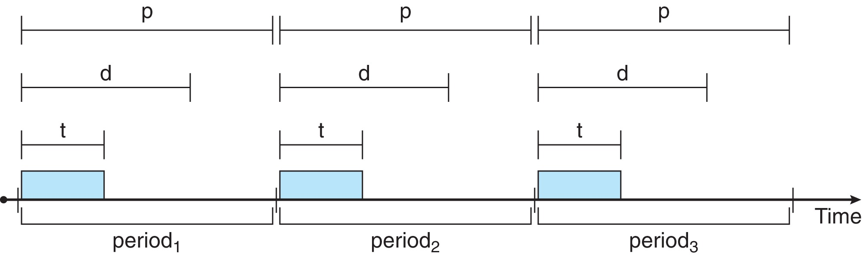
Priority-based Scheduling
Note that providing a preemptive, priority-based scheduler only guarantees soft real-time functionality. Processes have the characteristics: periodic ones require CPU at constant intervals (periods)
Has processing time t, deadline d, period p , in which 0 ≤ t ≤ d ≤ p
The rate of a periodic task is 1/p
A process may have to announce its deadline requirements to the scheduler. The scheduler decides whether to admit the process or not depending on whether it can guarantee that the process will complete on time (by its deadline)

Slide 48
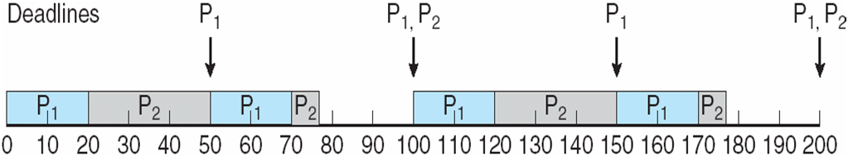
Rate Montonic Scheduling
A static priority is assigned based on the inverse of its period
Shorter (longer) period = higher (lower) priority;
The rationale is to assign a higher priority to tasks requiring CPU more often
Suppose P₁ has a period of 50 (also deadline), and processing time 20. P₂ has a period of 100 (also deadline), and processing time 35.
The deadline for each process requires that it complete its CPU burst by the start of its next period. Since 50 < 100, P₁ is assigned a higher priority than P₂
The CPU utilization of a process P_{i} as the ratio of its burst to its period t_{i}/P_{i} the CPU utilization of P₁ is 20/50 = 0.40 and that of P₂ is 35/100 = 0.35, so the total CPU utilization of 75 percent

Slide 49
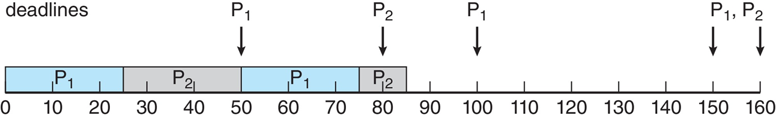
Missed Deadlines with Rate-Monotonic Scheduling
Suppose P₁ has a period of 50 (also deadline), and processing time 25. P₂ has a period of 80 (also deadline), and processing time 35.
Since 50 < 80, P₁ is assigned a higher priority than P₂
The CPU utilization of P₁ is 25/50 = 0.50 and that of P₂ is 35/80 = 0.44, for a total CPU utilization of 94 percent
Process P2 misses the deadline (80) by finishing at time 85

Slide 50
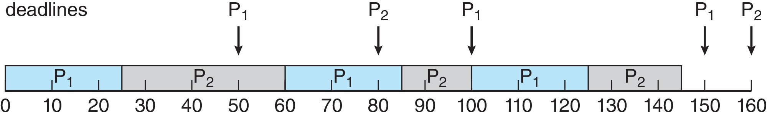
Earliest Deadline First Scheduling (EDF)
Earliest-deadline-first (EDF) scheduling assigns priorities dynamically according to the deadline
the earlier (later) the deadline, the higher (lower) the priority
Consider the same example, where P1 has a period of 50 (also deadline), and processing time 25. P2 has a period of 80 (also deadline), and processing time 35.

Slide 51
Rate-monotonic vs. EDF Scheduling
The rate-monotonic scheduling algorithm schedules periodic tasks using a static priority policy with preemption
The rate-monotonic scheduling is considered to be optimal in that if a set of processes cannot be scheduled by this algorithm, it cannot be scheduled by any other algorithm that assigns static priorities.
Unlike the rate-monotonic algorithm, EDF scheduling does not require that processes be periodic, nor must a process require a constant amount of CPU time per burst. The only requirement is that a process announce its deadline to the scheduler when it becomes runnable
EDF scheduling is theoretically optimal - it can schedule processes such that each process can meet its deadline requirements and CPU utilization will be 100 percent
In practice, however, it is impossible to achieve this level of CPU utilization due to the cost of context switching between processes and interrupt handling

Slide 52
Algorithm Evaluation
Selecting CPU-scheduling algorithm in practice can be difficult – as there are many scheduling algorithms, each with its own set of parameters
The first problem is defining the criteria to be used in selecting an algorithm - often defined in terms of CPU utilization, response time, or throughput
Determine criteria – the criteria may include several measures with their relative importance, such as
Maximizing CPU utilization under the constraint that the maximum response time is 300 milliseconds
Maximizing throughput such that turnaround time is (on average) linearly proportional to total execution time

Slide 53
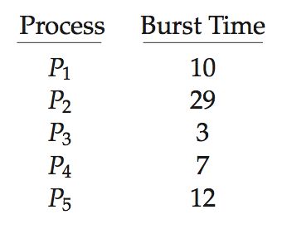
Deterministic Modeling
Deterministic modeling takes a particular predetermined workload and defines the performance of each algorithm for that workload
Deterministic modeling is simple and fast. It gives us exact numbers, to compare algorithms. However, it requires exact numbers for input, and its answers apply only to those cases
How processes run vary from time to time, so there is no static set of processes (or times) to use for deterministic modeling
Consider 5 processes arriving at time 0:

Slide 54
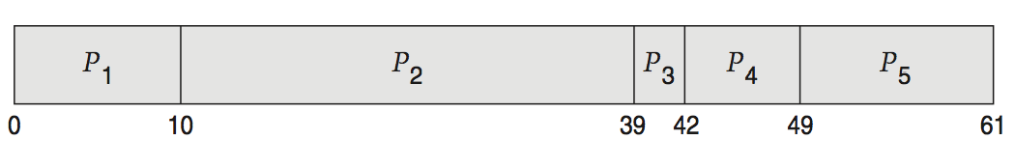
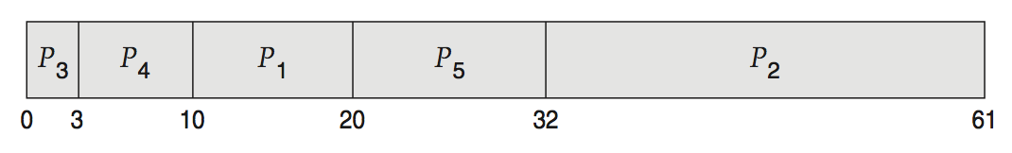
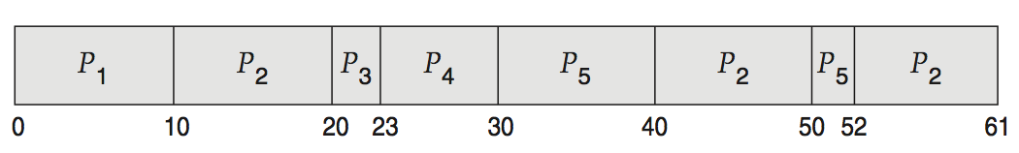
Deterministic Evaluation
For each algorithm, calculate the average waiting time
Simple and fast, but requires exact numbers for input, applies only to those inputs
FCS is 28ms:
Non-preemptive SFJ is 13ms:
RR is 23ms:

Slide 55
Queueing Analysis
Though the actual numbers (e.g. process arrival time, CPU or I/O bursts) vary from time (system) to time (system), the distributions of CPU and I/O bursts, and process arrival-time can be possibly measured and then approximated or simply estimated
The computer system can be described as a network of servers, and each server has a queue of waiting processes.
The CPU is a server with its ready queue, I/O system with its device queues
Commonly use the exponential distribution, and described by mean
Knowing arrival rates and service rates, we can compute the utilization, average queue length, average wait time, and so on.
This area of study is called queueing-network analysis
Queueing analysis can be useful in comparing scheduling algorithms, but the classes of algorithms and distributions that can be handled are very limited. Often the assumptions for the mathematical models to be tractable are unrealistic in practice

Slide 56
Queueing Models
Mathematical approach for handling stochastic workloads
n = average queue length
W = average waiting time in queue
λ = average arrival rate into queue
Little’s Formula – in steady state (there are mathematical assumptions for this to hold, e.g., arrival rate must be smaller than service rate), processes leaving queue must equal processes arriving, thus: n = λ x W
Valid for any scheduling algorithm and arrival distribution
For example, if on average 7 processes arrive per second, and normally 14 processes in queue, then average wait time per process = 2 seconds

Slide 57
Simulations
Queueing models is restricted to a few known distributions
Running simulations involves programming a model of the computer system – which is more accurate
As the clock value is increased, the simulator modifies the system state to reflect the activities of the devices, the processes, and the scheduler.
As the simulation executes, statistics that indicate algorithm performance are gathered and printed.
The data to drive the simulation can be generated in several ways
Random number generator according to probability distributions - distributions can be defined mathematically (uniform, exponential, Poisson) or empirically
Trace files to monitor the real system and record the sequence of actual events

Slide 58
Evaluation of CPU Schedulers by Simulation

Slide 59
Implementation
Even simulations have limited accuracy
Build a system which allows actual algorithms to run with real data set – more flexible and general.
Implementing a new scheduler and test in real systems has difficulties:
This incurs high cost (coding the new scheduler), and high risk (e.g., potentially introducing new bugs)
Environments also changes constantly
Most flexible scheduling algorithms are those that can be altered by the system managers so that they can be tuned for a specific application
A system supporting graphical applications or web (file) service, for instance, may have different scheduling needs
Many UNIX systems allow the system manager to fine-tune the scheduling parameters for a particular system configuration
APIs can be used to modify priority of a process or thread – improving performance of specific application, not overall application performance
The Java, POSIX, and Windows APIs provide such functions

Slide 60
End of Chapter 5

